Slide 1
Central Maintenance Facility Community Update
September 7, 2019
Notes:
This slide up while people assemble in room

Slide 2
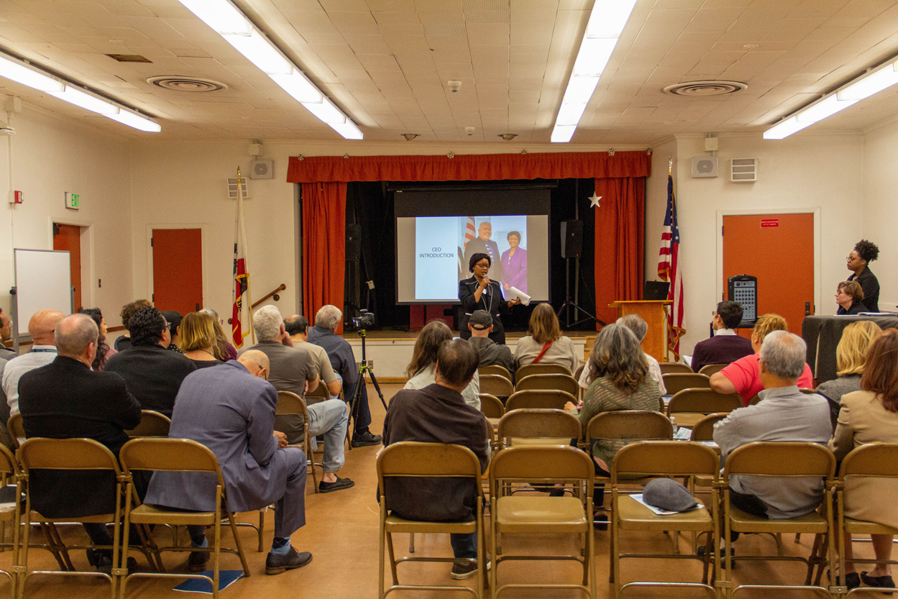
WELCOME
Spanish Translation Available
Notes:
Opening: Laurene Lopez says hello and welcomes Eric Hosey, Chief Operating Officer to provide Safety Briefing (Rod Bailey as back-up)
Mary McCormick- welcome audience and describe slightly different meeting format.
Sylvia Novoa who can provide Spanish translation

Slide 3
Agenda
Agenda
Welcome
Summer updates
CMF Action Plan update
What you can expect
Questions and answers
Notes:
Presenter: Mary McCormick (Facilitator)
Welcome and thank you for attending our first quarterly meeting to provide updates on our Action Plan.
Today will go cover:
Summer updates
CMF Action Plan update
What you can expect
Questions and Answers - You should have received a comment or question card if you would like to participate in the Q & A session at the conclusion of our presentation.
Introduce our CEO Stephanie Wiggins

Slide 4
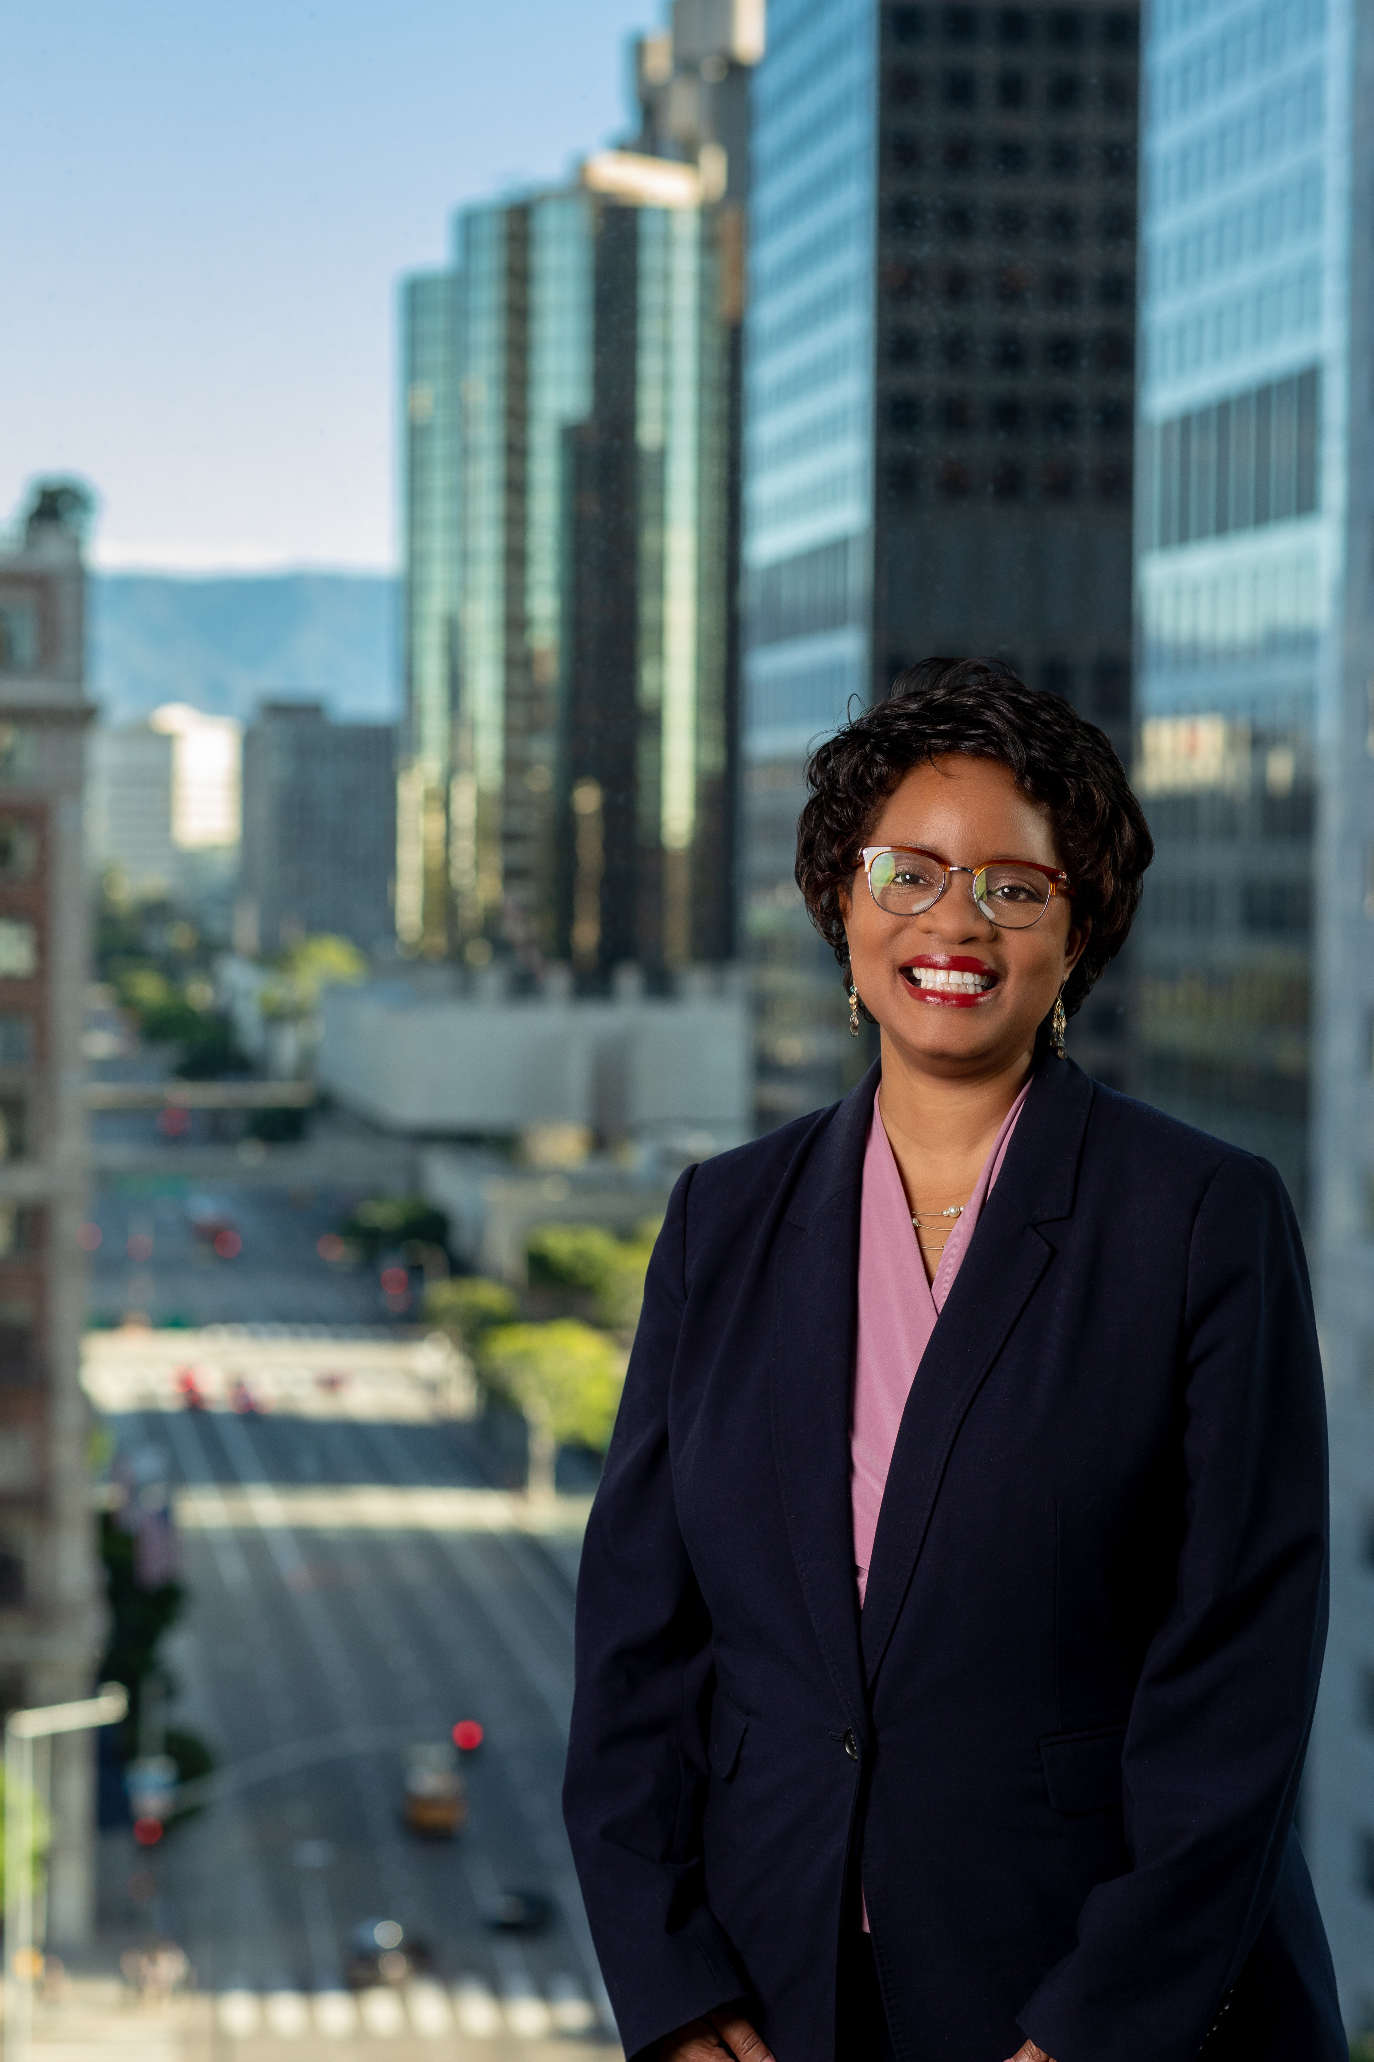
CEO Introduction
CEO
"Create Value, Exceed Expectations."
Customer-focused vision:
Safety and security
An integrated system
Modernizing business practices
Notes:
Presenter: Stephanie Wiggins, CEO
I joined Metrolink on January 2nd and meeting with this community was a top priority.
I rolled out my vision to focus on the customer. My vision statement is to “Create Value and Exceed Expectations” – and that’s what I plan to do for this community.
"Create Value, Exceed Expectations."
Customer-Focused Vision:
Safety and Security
An Integrated System
Modernizing Business Practices

Slide 5
Summer Updates
Update
Record ridership
Farewell to Locomotive 800
Metrolink Cares
City of Los Angeles Taylor Yard G2 River Park Project
Your neighborhood leadership team
Notes:
Presenter: Stephanie Wiggins, CEO
Record Ridership
Metrolink had the highest ridership in its almost 27-year history, last fiscal year
More than 11.9 million boardings last year
The previous record was set 10 years ago when gas prices were the highest in history
Farewell to Locomotive 800 – The Oldest, loudest continuously active engine in Metrolink’s fleet having started its service in 1981 in an Amtrak locomotive before coming to Metrolink in 2005.
Locomotive 800 - Least favorite piece of equipment has taken its last ride (2005- 2019) - 14 years
As part of our process of having a more environmentally friendly fleet, we’ve brought in these Tier 4 locomotives and we’ve decommissioned less efficient trains including this one.
South Coast Air Quality Management District (SCAQMD) visited the Central Maintenance Facility (CMF) to certify the engine block of Engine No. 800 was drilled, permanently disabling the
engine
Metrolink Cares
This summer we launched the Metrolink Cares program where the agency is supporting other causes that improve lives for the people in the community we serve. Metrolink connects people to opportunity and Metrolink Cares helps people to connect to resources that can help them.
Some examples:
American Heart Association – supporting Pasadena Heart Walk on Sept. 28
Tierra del Sol
The Wiley Center
City of Los Angeles Taylor Yard G2 River Park Project
Kick-off this summer
42-acre project
G2 parcel is one portion of a 244-acre property and is an open space along the LA River
Construction impacts are communicated to the local residents
Noise from this project is not a part of a Metrolink project contact Lyndsay.naish@lacity.org for more information
Your Neighborhood Leadership Team – And we are excited about some new additions we’ve made to the team that serves you.
(next slide)

Slide 6
Your Neighborhood Leadership Team
Leadership
Operations:
Eric Hosey, Chief Operating Officer
Justin Fornelli, Chief, Program Delivery
Darrell Maxey, Chief Mobilization, Transition and Special Projects
Rod Bailey, Deputy Chief Operating Officer
Luis Carrasquero, Interim Director, Maintenance of Equipment
Eric Poghosyan, Senior Manager, Facilities and Fleet Maintenance
Community Relations:
Todd McIntyre, Chief Strategy Officer
Jeff Dunn, Director of Government Relations
Alex Davis, Senior Manager, Government Relations
Sylvia Novoa, Community Relations Manager*
Javier Hernandez, SCORE Community Relations Manager
*Day-to-Day contact
Notes:
Presenter: Stephanie Wiggins – CEO
Introduce my NEIGHBORHOOD LEADERSHIP TEAM
Operations:
Eric Hosey, Chief Operating Officer
Justin Fornelli, Chief, Program Delivery
Darrell Maxey, Chief Mobilization, Transition and Special Projects
Rod Bailey, Deputy Chief Operating Officer
Luis Carrasquero, Interim Director, Maintenance of Equipment
Eric Poghosyan, Senior Manager, Facilities and Fleet Maintenance
Community Relations:
Todd McIntyre, Chief Strategy Officer
Jeffery Dunn, Director, Government Relations
Alex Davis, Senior Manager, Government Relations
Sylvia Novoa, Community Relations Manager
Javier Hernandez, SCORE Community Relations Manager
Transition to Action Plan

Slide 7
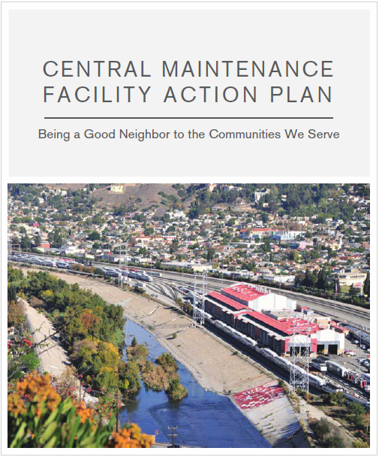
Central Maintenance Facility Action Plan
Action Plan
Metrolink's 11-point plan to be a better neighbor to communities adjacent to the CMF
Includes short-, medium- and long-term efforts to reduce noise and emissions, as well as efforts to ensure accountability
Notes:
Presenter: Stephanie Wiggins, CEO
As a result of the concerns raised by the community at the April 11 meeting Metrolink team developed an Action Plan starting in May 2019.
Definition: An 11-point plan to create accountability and transparency to the community as we modernize the CMF.
Metrolink's 11-point plan to become a better neighbor to the communities adjacent to the CMF.
Includes short, medium and long-term efforts to reduce noise and emissions, as well as efforts to ensure accountability.

Slide 8
Central Maintenance Facility Action Plan Progress
Action Plan
Short-term (0-6 months) | Mid-term (6-18 months) | Long-term (18+ months)
Optimize use of ground power stations (Completed) Installation of Sound Monitors (Completed) Internal Audit - 20% complete Independent New Noise Study - 5% complete Expedite 8 Tier 4 Locomotives into service Change the Accountability Metrics of the Equipment Maintenance Contractor (Completed) | Fleet Modernization Study - 8% complete CMF Modernization Study - 8% complete Complete deployment of 40 Tier 4 Locomotives - 58% complete | Work towards a Zero-Emissions Future - 6% complete New contracting approach system-wide goes in effect with new accountability metrics. – 30% complete
Short-term (0-6 months) | Mid-term (6-18 months) | Long-term (18+ months)
Optimize use of ground power stations (Completed) Installation of Sound Monitors (Completed) Internal Audit - 20% complete Independent New Noise Study - 5% complete Expedite 8 Tier 4 Locomotives into service Change the Accountability Metrics of the Equipment Maintenance Contractor (Completed) | Fleet Modernization Study - 8% complete CMF Modernization Study - 8% complete Complete deployment of 40 Tier 4 Locomotives - 58% complete | Work towards a Zero-Emissions Future - 6% complete New contracting approach system-wide goes in effect with new accountability metrics. – 30% complete
Notes:
Presenter: Stephanie Wiggins, CEO
The plan is divided into three time frames: Short-term (0-6 months), Mid-term (6-18 months) and Long-term (18+months).
I’m proud that the team has completed the majority of our short term commitments and we continue to make progress on other commitments. Our team is going to go through each commitment one by one and give you an update.
Transition to : Eric Hosey, Chief Operations Officer/ Rod Bailey, Deputy Chief Operating Officer

Slide 9
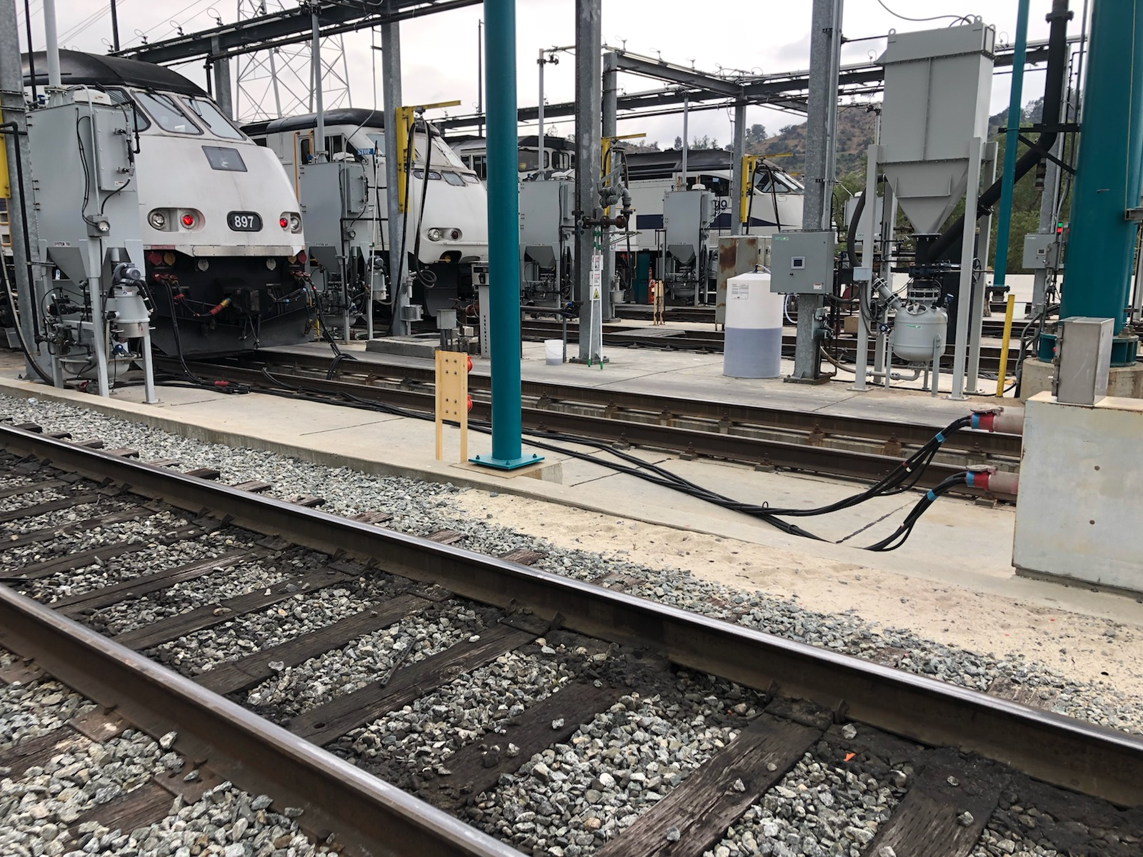
1. Optimize Use of Ground Power Stations -- COMPLETE
Short-term
Completion Timeframe: August 1, 2019
Benefits: Cleaner air and less noise
Progress:
Tracked power stations to evaluate usage and to determine how we can improve compiled an analysis
Findings:
Inconsistent use by contractors
Malfunctioning ground power stations
Actions taken:
Repaired ground power stations
Sent official notice to Bombardier
New procedures to track and document plug-in
Work with contractor to enhance ground power optimization to begin next week
Results: Adding 4 more train sets using ground power during servicing will reduce up to 150 hours of idling a month
Notes:
Presenter: Eric Hosey, Chief Operations Officer/ Rod Bailey, Deputy Chief Operating Officer presents metrics (slides 9, 10, 11, 12 )
Benefits: Cleaner air and less noise
Progress:
Tracked power stations to evaluate usage and to determine how we can improve compiled an analysis
Findings:
Inconsistent use by contractors
Malfunctioning ground power stations
Actions taken:
Repaired ground power stations
Sent official notice to Bombardier
New procedures to track and document plug-in
Work with contractor to enhance ground power optimization to begin next week
Results: Adding 4 more train sets using ground power during servicing will reduce up to 150 hours of idling a month

Slide 10
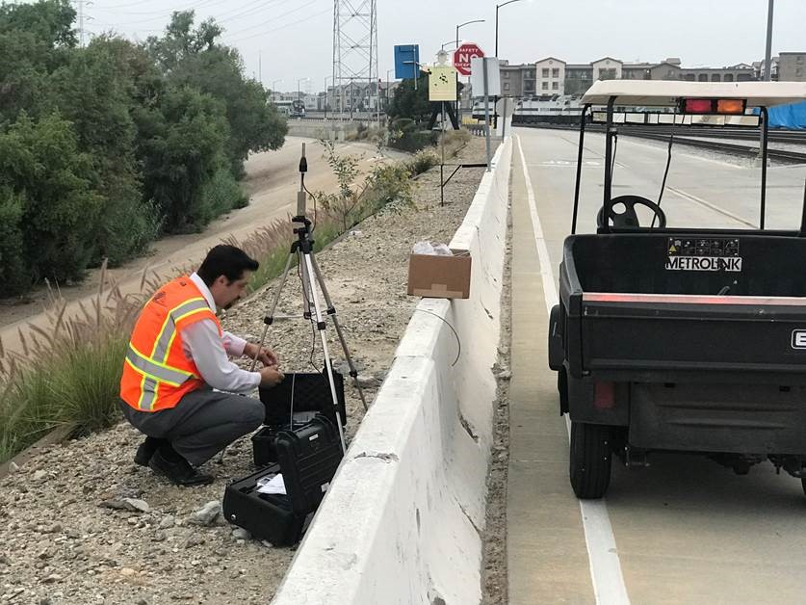
Short-term
2. Installation of sound monitors -- COMPLETE
Completion Timeframe: July 1, 2019
Benefits: Less noise
Progress:
Monitored sound for three weeks in ten locations
Findings:
Noise levels highest during the horn and load testing throughout the day
Actions taken:
Requested quotes for permanent sound monitor installation to provide internal information and accountability
Results:
Metrolink is aware of noise levels in the yard and can take action
Metrolink to install permanent sound monitors
Notes:
Presenter: Eric Hosey, COO/Rod Bailey, Deputy Chief Operating Officer presents metrics (slides 9, 10, 11, 12)
Benefits: Less noise
Progress:
Monitored sound for three weeks in ten locations
Findings:
Noise levels highest during the horn and load testing throughout the day
Actions taken:
Requested quotes for permanent sound monitor installation to provide internal information and accountability
Results:
Metrolink is aware of noise levels in the yard and can take action
Metrolink to install permanent sound monitors

Slide 11
20%
Short-term
3. Internal Performance Audit Report – IN PROGRESS
Completion Timeframe: November 9, 2019
Benefits: Cleaner air and less noise
Progress:
Metrolink’s Internal Audit Department had a kickoff meeting with departments involved
Internal Audit toured the CMF Facility
Internal Audit gathered procedures and materials from involved departments
Findings:
To be determined by performance audit
Next Steps:
Internal Audit will review compliance to commitments made to the community
Audit procedures will include community member feedback and details will be provided in the monthly CMF newsletter
Notes:
Presenter: Eric Hosey, COO/Rod Bailey, Deputy Chief Operating Officer presents metrics (slides 9, 10, 11, 12)
Benefits: Cleaner air and less noise
Progress:
Metrolink’s Internal Audit Department had a kickoff meeting with various departments involved
Internal Audit toured the CMF Facility
Internal Audit gathered procedures and materials from involved departments
Findings:
To be determined by performance audit
Next Steps:
Internal Audit will review compliance to commitments made to the community
Audit procedures will include community member interviews and details will be provided in the monthly CMF newsletter

Slide 12
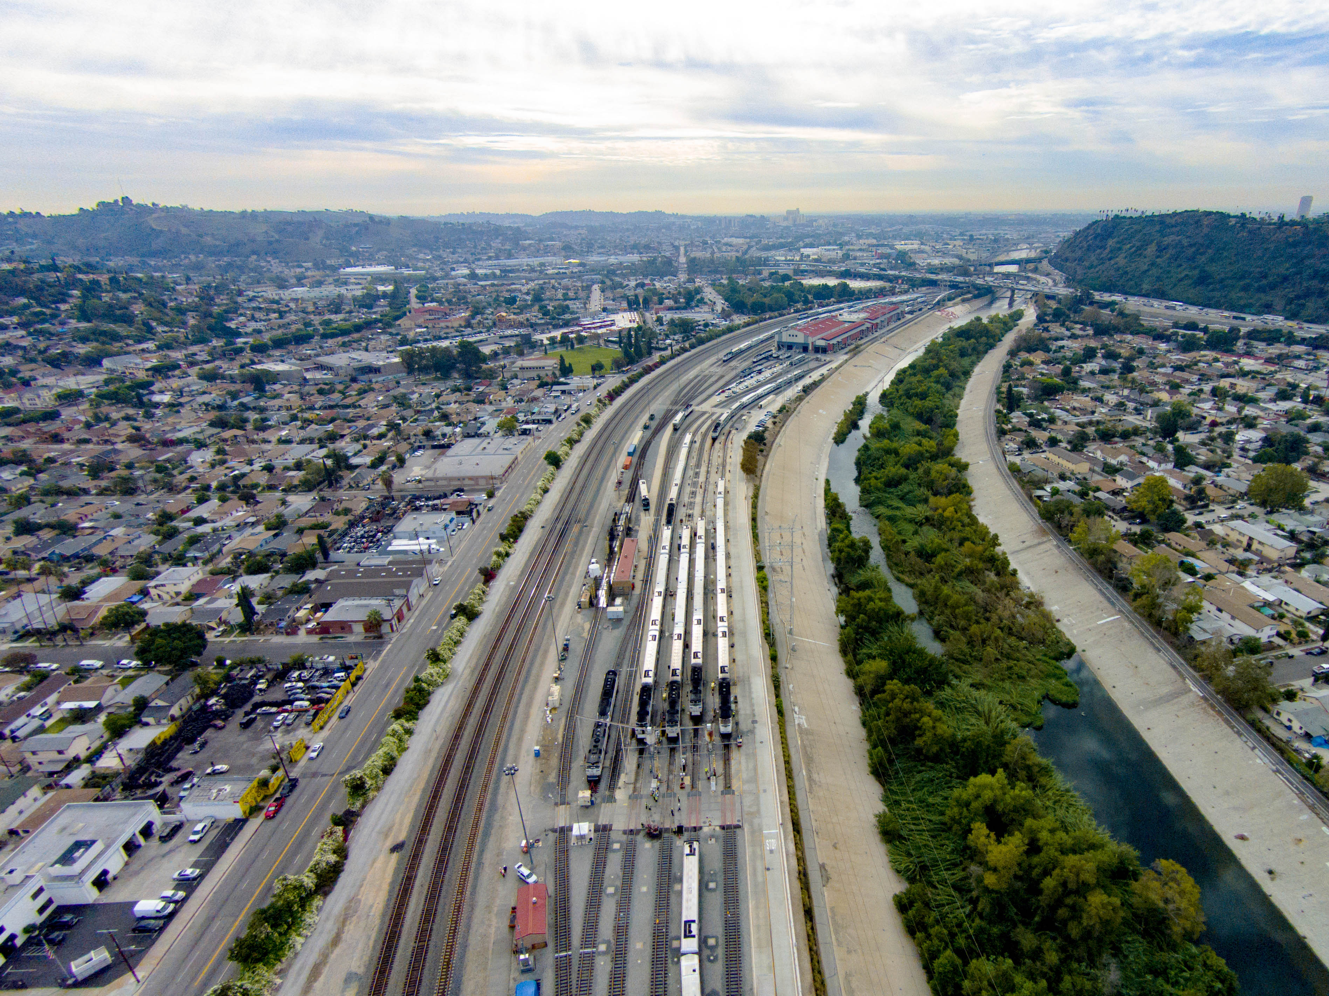
4. Independent New Noise Study – IN PROGRESS
5%
Short-term
Completion timeframe: November 9, 2019
Benefits: Less noise
Progress:
Metro provided scope of work to contractor for quote for study
Findings:
To be determined by noise study
Next Steps
Identify funding
Begin procurement process
Notes:
Presenter: Eric Hosey, COO/Rod Bailey, Deputy Chief Operating Officer presents metrics (slides 9, 10, 11, 12)
Benefits: Less noise
Progress:
Metro provided scope of work to contractor for quote for study
Findings:
To be determined by noise study
Next Steps
Identify funding
Begin procurement process
Transition to: Justin Fornelli Chief, Program Delivery

Slide 13
Short-term
5. Expedite 8 Tier 4 locomotives into service -- COMPLETE
Completion timeframe: November 9, 2019
Benefits: Cleaner air
Progress:
Metrolink has deployed Tier 4 locomotives each month since the Action Plan began in May 2019
8 new locomotives have been deployed, for a total of 23 locomotives in service
This goal was completed August 20, 2019 -- ahead of schedule
Results:
Eight Tier 4 locomotives only emit 19.6 tons of NO_{x} and particulate matter, while the eight decommissioned Tier O emitted 129.6 NO_{x} and particulate matter per year
84.88% reduction in emissions
Notes:
Presenter: Justin Fornelli, Chief, Program Delivery (Slide 13)
Benefits: Cleaner air
Progress:
Metrolink has deployed Tier 4 locomotives each month since the Action Plan began in May 2019
8 new locomotives have been deployed, for a total of 23 locomotives in service
This goal was completed August 20, 2019 -- ahead of schedule
Results:
Eight Tier 4 locomotives only emit 19.6 tons of NO_{x} and particulate matter, while the eight decommissioned Tier O emitted 129.6 NO_{x} and particulate matter per year
84.88% reduction in emissions
Transition to Darrell Maxey, Chief, Mobilization, Transition and Special Projects (14-19)

Slide 14
Short-term
6. Change the Accountability Metrics of the Equipment Maintenance Contractor -- COMPLETE
Completion Timeframe: July 1, 2019
Benefits: Cleaner air and less noise
Progress:
Metrolink staff included new accountability metrics as part of the new maintenance contracts which are being advertised
Findings:
Insufficient contract requirements pertaining
to neighborhood impacts
Actions taken:
Revised new contract language
Results:
Assessments are included in contract (monetary penalties for non-compliance up to $5,000)
Actual language from document
Notes:
Presenter: Darrell Maxey, Chief, Mobilization, Transition and Special Projects (slides 14-16)
Benefits: Cleaner air and less noise
Progress:
Metrolink staff included new accountability metrics as part of the new maintenance contracts which are being advertised
Findings:
Insufficient contract requirements pertaining
to neighborhood impacts
Actual language from document
METROLINK MAINTENANCE FACILITY OPERATIONS STANDARDS
“GOOD NEIGHBOR” STANDARDS & PRACTICES
This standard applies to any maintenance facilities located near residential neighborhoods. The Contractor shall schedule and perform all train and facility maintenance and repair activities to minimize the impact of noise and emissions on the surrounding community.
Actions taken:
Revised new contract language
Results:
Assessments are included in contract (monetary penalties for non-compliance up to $5,000)

Slide 15
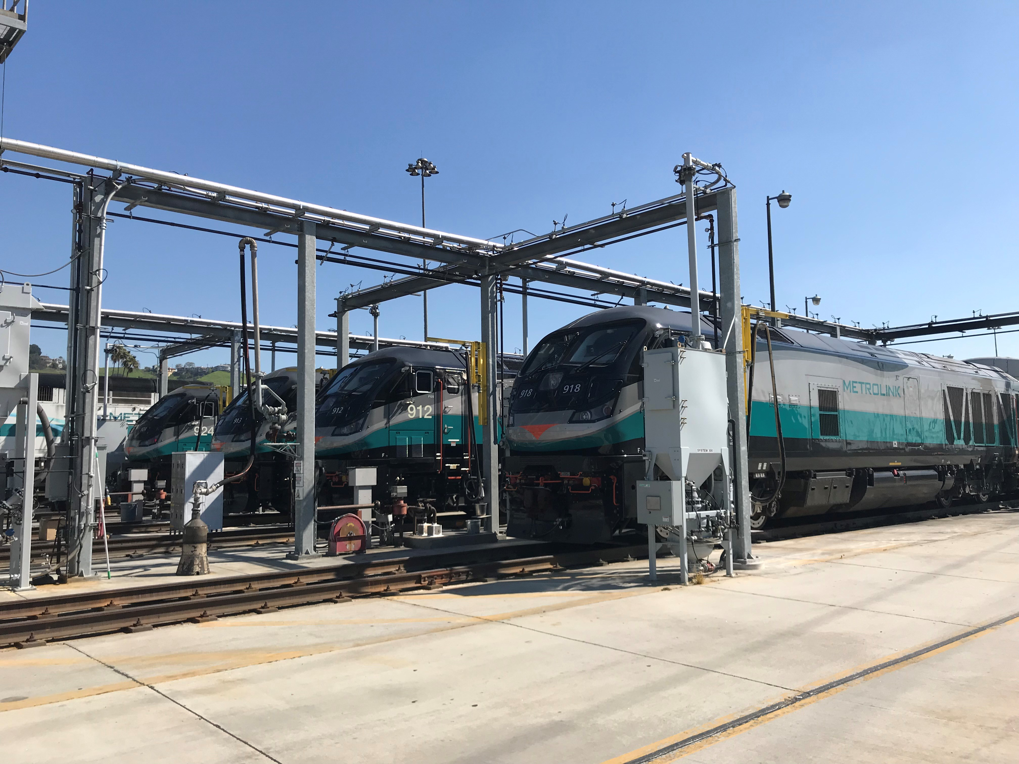
8%
Mid-term
7. Fleet Modernization Study – IN PROGRESS
Completion Timeframe: Winter 2020 to commence study
Benefits: Cleaner air and less noise
Progress:
Developed a draft of the study scope and schedule
Secured approval for study funding in FY20 budget
Scope identifies and recommends improvements to address community impact concerns
Findings:
To be determined upon completion of the study
Next steps:
Finalize scope and schedule Sept. 30, 2019
Notes:
Presenter: Darrell Maxey – Chief Mobilization, Transition and Special Projects, (slides 14-16)
Benefits: Cleaner air and less noise
Progress:
Developed a draft of the study scope and schedule
Secured approval for study funding in FY20 budget
Scope identifies and recommends improvements to address community impact concerns
Findings:
To be determined upon completion of the study
Next steps:
Finalize scope and schedule Sept. 30, 2019

Slide 16
8%
Mid-term
8. CMF Modernization study – IN PROGRESS
Completion timeframe: November 1, 2020
Benefits: Cleaner air and less noise
Progress:
Developed a draft of the study scope and schedule
Secured approval for study funding in FY20 budget
Scope identifies and recommends improvements to address community impact concerns
Staff met with Advanced Engineering Group (hood technology manufacturer)
Findings:
To be determined upon completion of the study
Next steps:
Finalize scope and schedule Sept. 30, 2019
Notes:
Presenter: Darrell Maxey – Chief Mobilization, Transition and Special Projects, (slides 14-16)
Benefits: Cleaner air and less noise
Progress:
Developed a draft of the study scope and schedule
Secured approval for study funding in FY20 budget
Scope identifies and recommends improvements to address community impact concerns
Staff met with Advanced Engineering Group (hood technology manufacturer)
Findings:
To be determined upon completion of the study
Next steps:
Finalize scope and schedule Sept. 30, 2019
Transition to Justin Fornelli

Slide 17
58%
Medium-term
9. Complete deployment of 40 Tier 4 Locomotives –
IN PROGRESS
Completion timeframe: Summer 2020
Benefits: Cleaner air
Progress:
23 locomotives have been deployed as of Aug. 2019
15 Tier O decommissioned
Findings:
23 Tier 4 locomotives only emit 56.35 tons of NO_{x} and particulate matter (PM) while the 15 decommissioned Tier O emitted 243 tons of NO_{x} and particulate matter (PM) per year
76% reduction in emissions
Next steps:
Deploy four additional locomotives by Dec. 31, 2019
Notes:
Presenter: Justin Fornelli, Chief, Program Delivery (Slide 17)
Benefits: Cleaner air
Progress:
23 locomotives have been deployed as of Aug. 2019
15 Tier O decommissioned
Findings:
23 Tier 4 locomotives only emit 56.35 tons of NO_{x} and particulate matter (PM) while the 15 decommissioned Tier O emitted 243 tons of NO_{x} and particulate matter (PM) per year
76% reduction in emissions
Next steps:
Deploy four additional locomotives by Dec. 31, 2019
Transition to Darrell Darrell Maxey – Chief Mobilization, Transition and Special Projects

Slide 18
10. Work towards a Zero-Emissions Future – IN PROGRESS
6%
Long-term
Completion Timeframe: Immediate and ongoing with specifics made possible by fleet modernization study.
Benefits: Cleaner air and less noise
Progress:
Met with major railroads and consultant working on battery-electric locomotive
Attended a Hydrogen Fuel Cell Workshop
CEO moderated zero emissions panel
Findings:
Learned about possible new technologies
Next steps:
Attend workshops to learn more about battery operated locomotives
Continually identify opportunities for zero emissions and deploy as feasible
Notes:
Presenter: Darrell Maxey, Chief, Mobilization, Transition and Special Projects (slides 18-19)
Benefits: Cleaner air and less noise
Progress:
Met with major railroads and consultant working on battery-electric locomotive
Attended a Hydrogen Fuel Cell Workshop
CEO moderated zero emissions panel
Findings:
Learned about possible new technologies
Next steps:
Attend workshops to learn more about battery operated locomotives
Continually identify opportunities for zero emissions and deploy as feasible

Slide 19
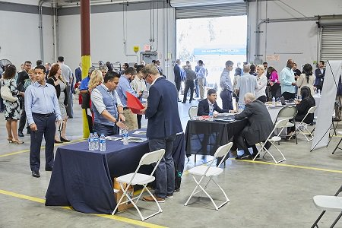
30%
Long-term
11. Implement new system-wide accountability measures – IN PROGRESS
Completion timeframe: Spring 2021
Benefits: Cleaner air and less noise
Progress:
Released request for proposals for bundled operations contract which adds accountability and steeper penalties for contractors working at CMF.
July 2019 - Proposal event and CMF tour given to prospective proposers
Next steps:
Proposals are due 4th Quarter, 2019
Start work 2021
Notes:
Presenter: Darrell Maxey, Chief, Mobilization, Transition and Special Projects Progress (slides 18-19)
Benefits: Cleaner air and less noise
Progress:
Released request for proposals for bundled operations contract which adds accountability and steeper penalties for contractors working at CMF.
July 2019 - Proposal event and CMF tour given to prospective proposers
Next steps:
Proposals are due 4th Quarter, 2019
Start work 2021
Transition to Eric Hosey, COO/Rod Bailey, Deputy Chief Operating Officer

Slide 20
What you can expect next
Next steps
October 2019 – New schedule goes into effect. Includes additional train service. One additional serviced at CMF during normal work hours
Less noise from Tier 4 engines when temperatures are lower
Shared right-of-way with freight line and Amtrak means not all train sounds are from Metrolink.
Notes:
Presenter: Eric Hosey, Chief Operations Officer/ Rod Bailey, Deputy Chief Operating Officer
October 2019 – New schedule goes into effect. Includes additional train service. One additional serviced at CMF during normal work hours
Less noise from Tier 4 engines when temperatures are lower
Shared right-of-way with freight line and Amtrak means not all train sounds are from Metrolink
Transition to Mary McCormick (Facilitator)

Slide 21
How to Reach Us
Contact us
metrolinktrains.com/community
communityrelations@scrra.net
24/7 Public Affairs Hotline: (213) 452-0400
Monthly CMF updates via email
Next Community Meeting: February 2020
Notes:
Presenter: Mary McCormick, Meeting facilitator – the Panel Discussion will begin
Start Q &A session with panelists
You can connect with us on the Internet, by email and by phone. We will also be providing updates on the CMF for those who are interested via email. (Keep this slide up during Q&A)

Slide 22
We would like to thank all customers, associates and partners for their support in enabling Metrolink to serve the community. In addition, we are hugely grateful to all participants for their time, insight and willingness to challenge views.

